Slide 1


SMART INDIA HACKATHON 2025
TITLE PAGE
Problem Statement ID – SIH25047
Problem Statement Title- Disaster Response drone
Theme- Robotics & Drones
PS Category- Hardware
Team ID-
Team Name – SkyAid

Slide 2

IDEA TITLE
PROPOSED SOLUTION
PROBLEM RESOLUTION
Delivers medical supplies and communication devices to remote disaster zones.
Overcomes access barriers from floods/earthquakes.
Integrates AI for real-time tracking and intelligent mapping.
Ensures precise, safe deliveries by dynamically adapting routes.
Drone Type: Fixed-wing convertible/motor VTOL UAV.
Payload Capacity: At least 5kg, tailored for medicine, communication gear, and small essentials.
Navigation: AI-enabled real-time obstacle avoidance and autonomous flight planning.
Operations: VTOL with tilting rotors enables vertical take-off/landing in constrained disaster zones; fixed-wing design maximizes range and speed for long-haul missions.
Support System: Integrated mobile app for live tracking, delivery management, and coordination with disaster teams.
Power & Endurance: High-efficiency battery packs, with modular swappable options for fast re-deployment.
Safety: Redundant stabilization systems, geo-fencing, and remote override for fail-safe operation.
UNIQUE VALUE PROPOSITIONS (UVP)
Hybrid VTOL/fixed-wing Y4 hybrid design with tilting frontal rotors delivers in remote/no-runway areas and covers large distances efficiently.
Quick deployment—ready-to-fly in minutes after disaster strikes.
AI-based route optimization reduces delivery time, increasing rescue effectiveness.
Payload versatility: Medical kits, radios, food, sensors.
Real-time coordination and analytics via integrated app.
Designed for reliability in rain, wind, and urban/rural terrain.

Slide 3
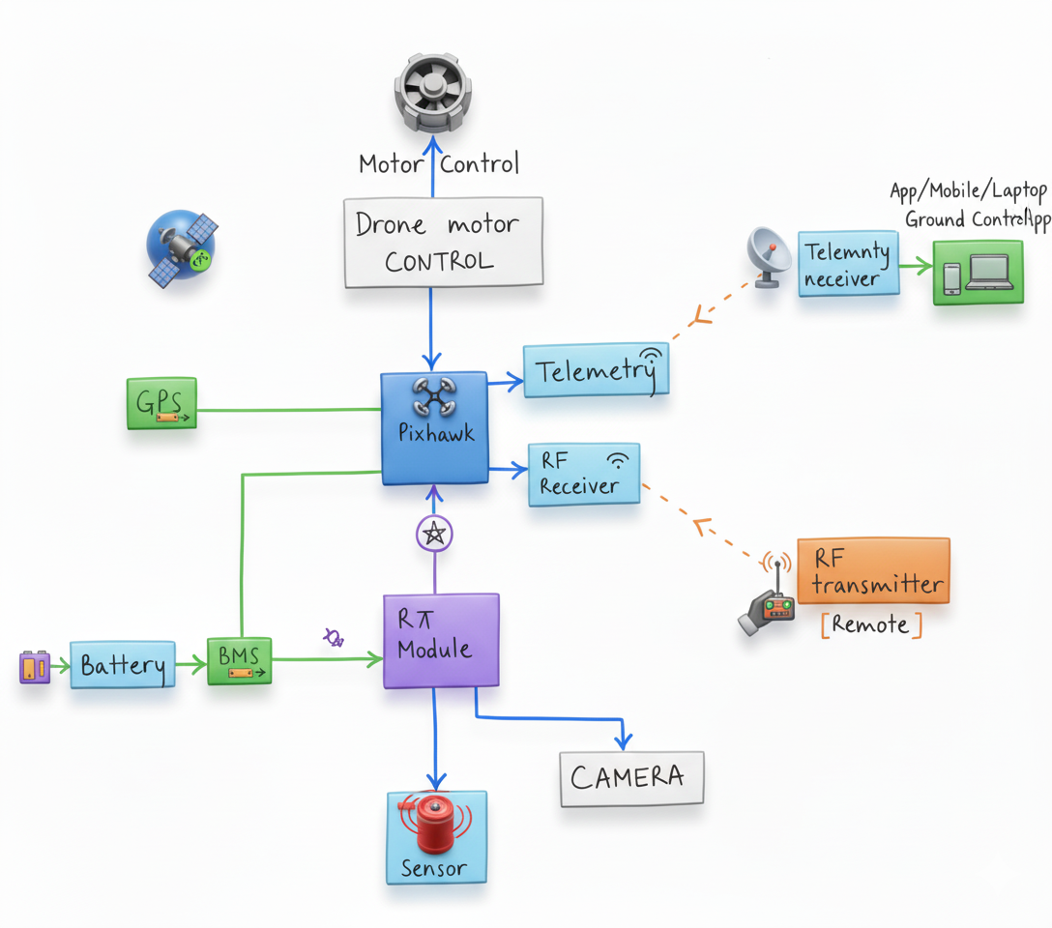
TECHNICAL APPROACH
PROCESS FLOW ARCHITECTURE
Design & Modeling
CAD design of fixed-wing convertible VTOL drone with Y4 configuration, 5 kg payload capacity, and frontal 2 tilting rotors for smooth transition from hover to forward flight. Simulations cover VTOL transitions, aerodynamics, and battery endurance.
Hardware Development
Assemble prototype with motors, sensors, batteries, and modular payload bay.
Use weather-resistant, lightweight materials; conduct initial flight tests.
AI Tracking & Mapping
Develop AI for real-time mapping, obstacle avoidance, and adaptive routing using sensor fusion.
Validate in simulation and disaster-like scenarios.
Mobile App Development
Create cross-platform app for mission planning, live drone tracking, and payload management.
Integrate with drone telemetry for real-time updates.
Integration & Testing
Combine drone hardware, AI, and app; perform field tests.
Refine based on feedback to ensure reliability under disaster conditions.

Slide 4
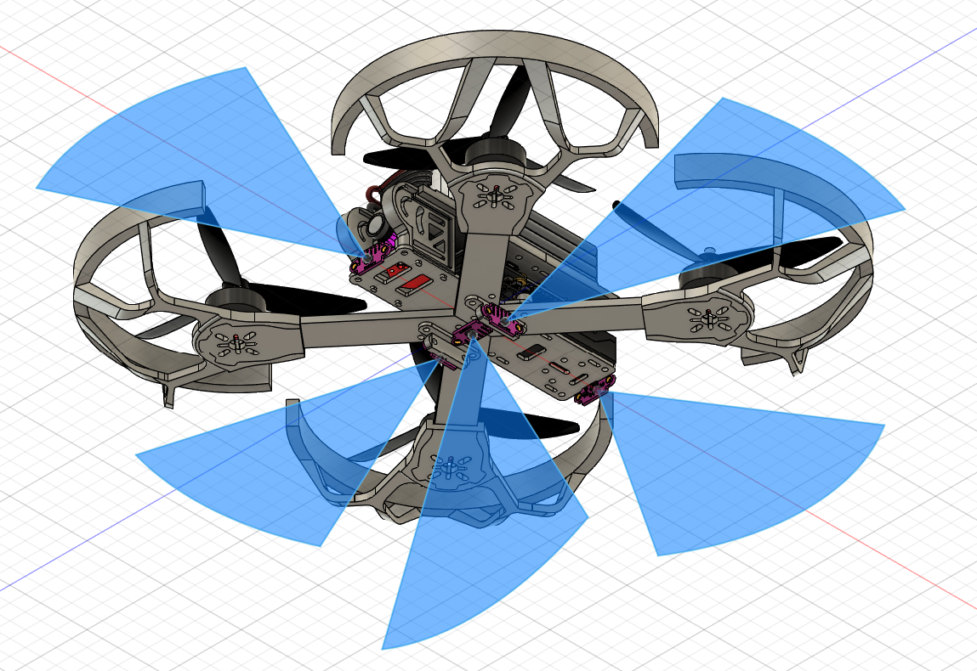
FEASIBILITY AND VIABILITY
Feasibility of the Idea
Proven fixed-wing VTOL drone tech and AI navigation enable practical implementation.
Off-the-shelf components facilitate rapid prototyping.
Mobile app integration improves coordination and control.
Aligns with current disaster response tech trends and requirements.
Incorporation of Y4 configuration with frontal tilting rotors for improved VTOL–fixed wing transition in final prototype.
Potential Challenges and Risks
Harsh weather conditions affecting flight stability.
Communication disruptions in remote or disaster-hit areas.
Limited battery life impacting range and payload.
Regulatory and airspace compliance requirements.
.
Strategies to Overcome Challenges
Use weather-resistant materials and rugged design.
Implement multi-channel comms: GSM, satellite backup.
Optimize flight paths and power use via AI.
Collaborate with authorities and train end-users effectively..
Field of View of LIDAR Sensors

Slide 5
IMPACT AND BENEFITS
Potential Impact on Target Audience
Benefits of the Solution
VTOL capability allows flexible deployment from confined spaces without runways.
Efficient, cost-effective alternative to manned vehicles, suitable for diverse disaster scenarios.
Scalable system that integrates AI and mobile coordination for precise, adaptive delivery missions.
Rapid aerial assessment and delivery in disaster zones speeds up response and saves lives.
Provides critical real-time data and access to otherwise unreachable locations, improving rescue operations.
Enhances safety by reducing the need for responders to enter hazardous environments.

Slide 6
RESEARCH AND REFERENCES
https://github.com/aditya4635/SkyAid/tree/main
GITHUB REPO for the project.
https://firmware.ardupilot.org/Copter/stable-4.6.2/Pixhawk1/Opensource Firmware for Flight Controller
https://www.raspberrypi.com/software/operating-systems/ Raspberry Pi OS.
https://ardupilot.org/planner/ Ground Control Station

